Slide 1
BRAIN TUMOR SEGMENTATION USING CONVOLUTIONAL NEURAL NETWORKS IN MRI IMAGES
By:
RUTH BALAJI (39130382)
R. SAKTHI AISHWARYA (39130389)
DEVADHARSHINI (39130108)
Guide- Dr. EMALDA ROSLIN

Slide 2
CONTENT
INTRODUCTION
LITERATURE SURVEY
OBJECTIVE
PROBLEM STATEMENT
EXISTING SYSTEM
PROPOSED SYSTEM
BLOCK DIAGRAM
BLOCK DIAGRAM DESCRIPTION
SYSTEM REQUIREMENTS
SOFTWARE REQUIREMENTS
WORKING
MRI IMAGES
OUTPUT
ADVANTAGES
DISADVANTAGES
REFERENCE

Slide 3
INTRODUCTION
Image processing is a method to perform some operations on an image, in order to get an enhanced image or to extract some useful information from it. It is a type of signal processing in which input is an image and output may be image or characteristics/features associated with that image.
A brain tumor is a mass or growth of abnormal cells in your brain.
Many different types of brain tumors exist. Some brain tumors are noncancerous (benign), and some brain tumors are cancerous (malignant). Brain tumors can begin in your brain (primary brain tumors), or cancer can begin in other parts of your body and spread to your brain as secondary (metastatic) brain tumors.
How quickly a brain tumor grows can vary greatly. The growth rate as well as the location of a brain tumor determines how it will affect the function of your nervous system.
Brain tumor treatment options depend on the type of brain tumor you have, as well as its size and location.

Slide 4
LITERATURE SURVEY
AUTHOR | TITLE OF THE PAPER | PROBLEM ADDRESSED
Dr. K. Sudha Rani, et al. (2021) | Identification of Brain Tumors using Volume rendering Techniques | The aim of this work is to compute the accurate volumes (3D) of tumors from 2D MR images. In MR images, the presence of tumor differs significantly because of the variation of the tissue cells. A perfect segmentation technique must be selected to separate the tumor tissue from the nearby healthy brain tissue to extract precise volume models. This research explains an effective technique for volume rendering of brain from 2D MRI slices. For medical research, the assessment of the pre-operative volume of tumor is highly essential. The 3D segmented tumor comprises of grey pixel values of the original MR image with well defined tumor edges.

Slide 5
OBJECTIVE
The main objective of the project is to propose an automatic segmentation method based on Convolutional Neural Networks (CNN), exploring the 3 × 3 kernels. By using small kernels we design a deeper architecture, besides having a positive effect against overfitting, given the fewer number of weight in the network. Data augmentation to be very effective for brain tumor segmentation in MRI Images.

Slide 6
PROBLEM STATEMENT
A brain tumor is a growth of cells in the brain or near it. Brain tumors can happen in the brain tissue. Brain tumors also can happen near the brain tissue. Nearby locations include nerves, the pituitary gland, the pineal gland, and the membranes that cover the surface of the brain. So in order, Magnetic Resonance Imaging (MRI) is a widely used imaging technique to assess these tumors, but the large amount of data produced by MRI prevents manual segmentation in a reasonable time, limiting the use of precise quantitative measurements in the clinical practice. We propose an automatic segmentation method based on Convolutional Neural Networks (CNN), exploring small 3×3 kernels. The use of small kernels allows designing a deeper architecture, besides having a positive effect against overﬁtting, given the fewer number of weights in the network. Data augmentation to be very effective for brain tumor segmentation in MRI images.

Slide 7
EXISTING SYSTEM
Support Vector Machines and Random Forests (RF) were successfully used in brain tumor segmentation.
The RF became very used due to its natural capability in handling multi-class problems and large feature vectors.

Slide 8
PROPOSED SYSTEM
We propose a novel CNN-based method for the segmentation of brain tumors in MRI images.
Use a binary CNN to identify the complete tumor. Then cellular automata smooth the segmentation.
The activation function LReLU was more important than ReLU in effectively training our CNN.

Slide 9
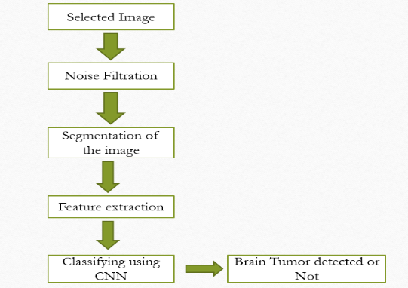
BLOCK DIAGRAM

Slide 10
BLOCK DIAGRAM DESCRIPTION
First the image selected for the processes listed below.
The selected image may have some noise so the image is filtered using a median filter.
Then the shape of the brain will be segmented using Otsu’s thresholding method.
Features of the selected image will be extracted using haar wavelet transform (HWT) and histogram of oriented gradients (HOG).
The extracted features will be classified with the training dataset using CNN
Finally the result will be displayed.

Slide 11
SYSTEM REQUIREMENTS
Windows 7 (or) higher
64-bit operating system
Disk Space
2 GB for MATLAB only,
4–8 GB for a typical installation.
Minimum 2GB RAM needed
No specific graphic cards required

Slide 12
SOFTWARE REQUIREMENTS
Mat lab 2016(A)
MATLAB is a scientific programming language and provides strong mathematical and numerical support for the implementation of advanced algorithms. It is for this reason that MATLAB is widely used by the image processing and computer vision community. New algorithms are very likely to be implemented first in MATLAB, indeed they may only be available in MATLAB.

Slide 13
WORKING
In this project, the MRI Images are used to detect whether the patient has Brain Tumor or not. We use D- planning technique, which uses three processes, they are preprocessing, segmentation, and classification. Classification is a backhand process, that is we train a database using a CRM. Preprocessing enhances the images, by increasing brightness, and contrast, and if there is any noise it removes it. Segmentation is of three types Kmean, ACM, and Watershed. Kmean shows images in black and white, ACM shows the region which is affected, and Watershed the images in a blur. Using the mat lab we first run the code, then we need to select the MRI Image that needs to be identified. After this, the selected image may have some noise so the image is filtered using a median filter. Then the shape of the brain will be segmented using Otsu’s thresholding method. Features of the selected image will be extracted using haar wavelet transform (HWT) and histogram of oriented gradients (HOG). The extracted features will be classified with the training dataset using CNN. Finally, the result will be displayed whether the brain is affected or not.

Slide 14
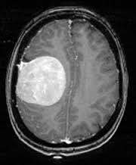
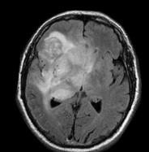
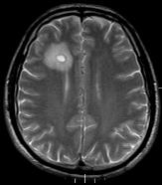
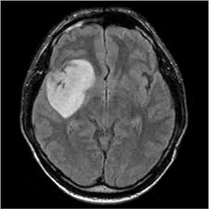
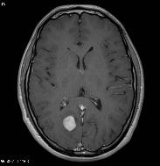
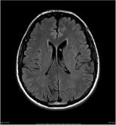
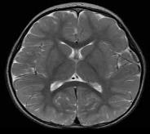
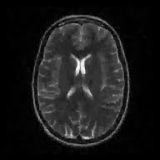
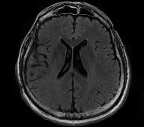
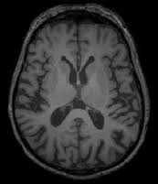
MRI IMAGES

Slide 15
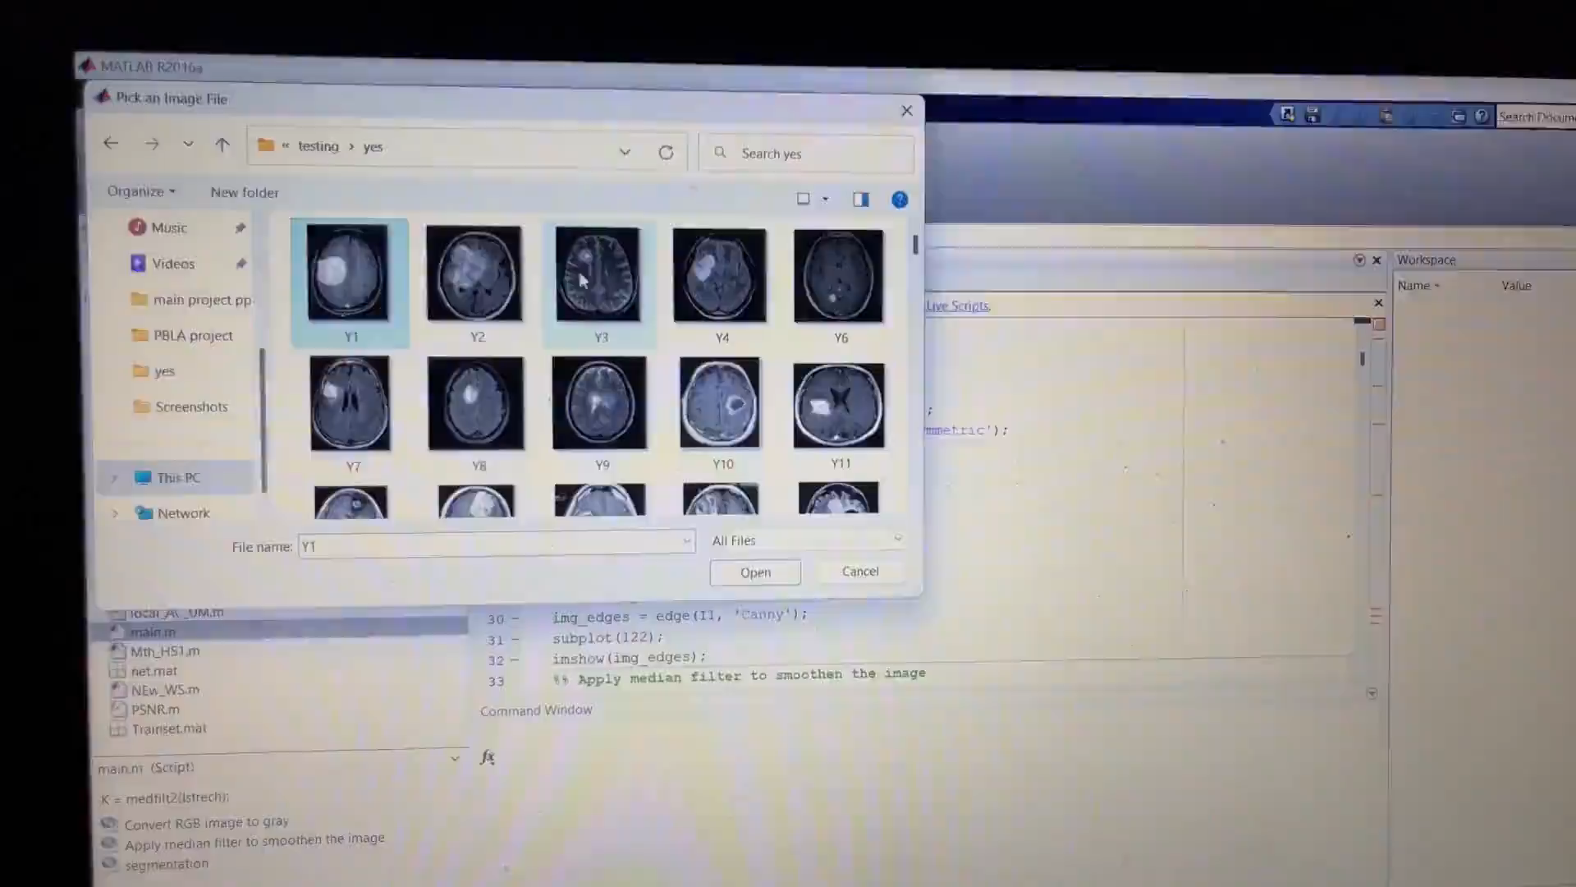

Slide 16
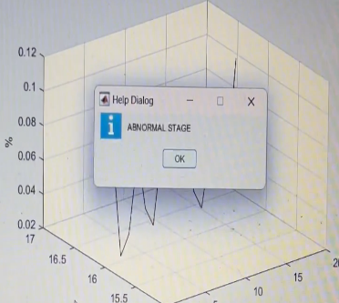
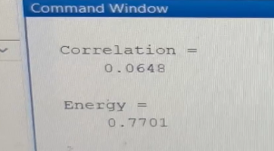
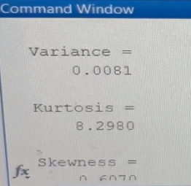
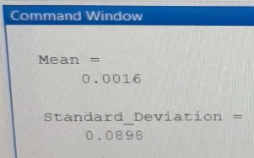
OUTPUT

Slide 17

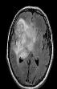
OUTPUT TABLE
IMAGE | STAGE | CORRELATION | ENERGY | MEAN | STANDARD DEVIATION | RMS | KURTOSIS | ACCURACY
 | ABNORMAL STAGE | 0.1990 | 0.7621 | 0.0031 | 0.0898 | 0.0898 | 7.3282 | 99.2%
 | ABNORMAL STAGE | 0.1502 | 0.7693 | 0.0031 | 0.0898 | 0.0898 | 7.3726 | 99.2%

Slide 18

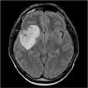
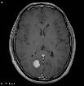
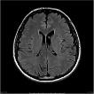
IMAGE | STAGE | CORRELATION | ENERGY | MEAN | STANDARD DEVIATION | RMS | KURTOSIS | ACCURACY
 | ABNORMAL STAGE | 0.0648 | 0.7701 | 0.0016 | 0.0898 | 0.0898 | 8.2980 | 99.2%
 | ABNORMAL STAGE | 0.1247 | 0.7488 | 0.0042 | 0.0897 | 0.0898 | 7.7305 | 99.2%
 | ABNORMAL STAGE | 0.1142 | 0.7554 | 0.0047 | 0.0897 | 0.0898 | 9.3640 | 99.2%
 | NORMAL STAGE | 0.1318 | 0.7746 | 0.0044 | 0.0897 | 0.0898 | 8.2850 | 99.2%

Slide 19

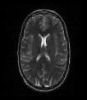


IMAGE | STAGE | CORRELATION | ENERGY | MEAN | STANDARD DEVIATION | RMS | KURTOSIS | ACCURACY
 | NORMAL STAGE | 0.0664 | 0.7493 | 0.0036 | 0.0897 | 0.0898 | 7.1184 | 99.2%
 | NORMAL STAGE | 0.0576 | 0.8254 | 0.0023 | 0.0898 | 0.0898 | 21.4385 | 99.2%
 | NORMAL STAGE | 0.1345 | 0.7803 | 0.0045 | 0.0898 | 0.0898 | 9.7959 | 99.2%
 | NORMAL STAGE | 0.0531 | 0.8757 | 0.0053 | 0.0897 | 0.0898 | 34.0145 | 99.2%

Slide 20
ADVANTAGES
CNN easier to train
Less prone to overﬁtting

Slide 21
DISADVANTAGES
Time-consuming.
Inter- and intra-rater errors are difﬁcult to characterize.

Slide 22
REFERENCES
D. Kwon et al., “Combining generative models for multifocal glioma segmentation and registration,” in Medical Image Computing and Computer-Assisted Intervention–MICCAI 2014. Springer, 2014, pp. 763–770.
Pinto et al., “Brain tumor segmentation based on the extremely randomized forest with high-level features,” in Engineering in Medicine and Biology Society (EMBC), 2015 37th Annual International Conference of the IEEE. IEEE, 2015, pp. 3037–3040.
K. Simonyan and A. Zisserman, “Very deep convolutional networks for large-scale image recognition,” arXiv preprint arXiv:1409.1556v6.

